Slide 1
INGUINAL CANAL
BY
F.O.OPOOLA

Slide 2
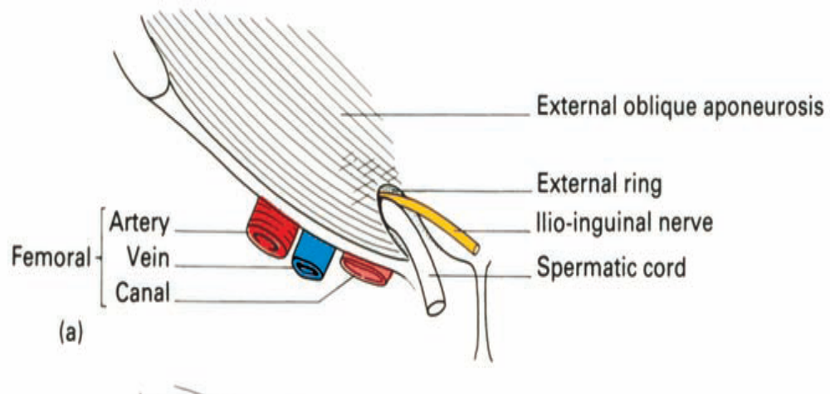
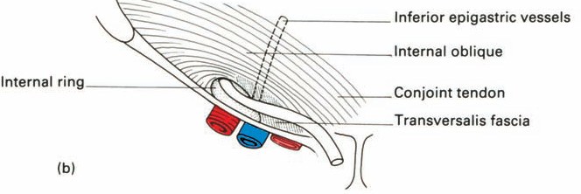
The inguinal canal is an oblique passage through the lower part of the anterior abdominal wall.

Slide 3
Boundaries
The inguinal canal is bordered by anterior, posterior, superior (roof) and inferior (floor) walls. It has two openings – the superficial and deep rings.
Walls
Anterior wall – aponeurosis of the external oblique, reinforced by the internal oblique muscle laterally.
Posterior wall – transversalis fascia.
Roof – transversalis fascia, internal oblique, and transversus abdominis.
Floor – inguinal ligament (a ‘rolled up’ portion of the external oblique aponeurosis), thickened medially by the lacunar ligament.
During periods of increased intra-abdominal pressure, the abdominal viscera are pushed into the posterior wall of the inguinal canal.
To prevent herniation of viscera into the canal, the muscles of the anterior and posterior wall contract, and ‘clamp down’ on the canal.

Slide 4
Rings
The two openings to the inguinal canal are known as rings. There are two rings – deep (internal) and superficial (external):
Deep (internal) ring:
  Marks the internal opening of the inguinal canal
  Found above the midpoint of the inguinal ligament (lateral to the epigastric vessels).
  The ring is created by the transversalis fascia, which invaginates to form a covering of the contents of the inguinal canal.
Superficial (external) ring:
  Marks the external end of the inguinal canal
  Lies just superior to the pubic tubercle.
  It is a triangle shaped opening, formed by the invagination of the external oblique, which forms another covering of the inguinal canal contents.
  It contains intercrural fibres, which run perpendicular to the aponeurosis of the external oblique and prevent the ring from widening

Slide 5
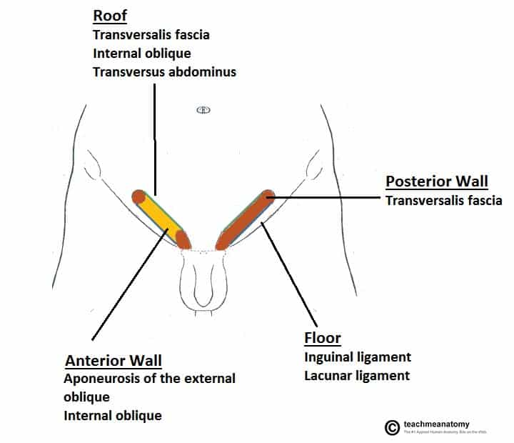

Slide 6
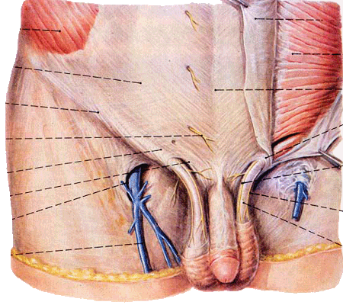
A horizontal line stretching from anterior iliac spine to lateral margin of rectus abdominis.
The inguinal canal is larger and more prominent in men.

Slide 7
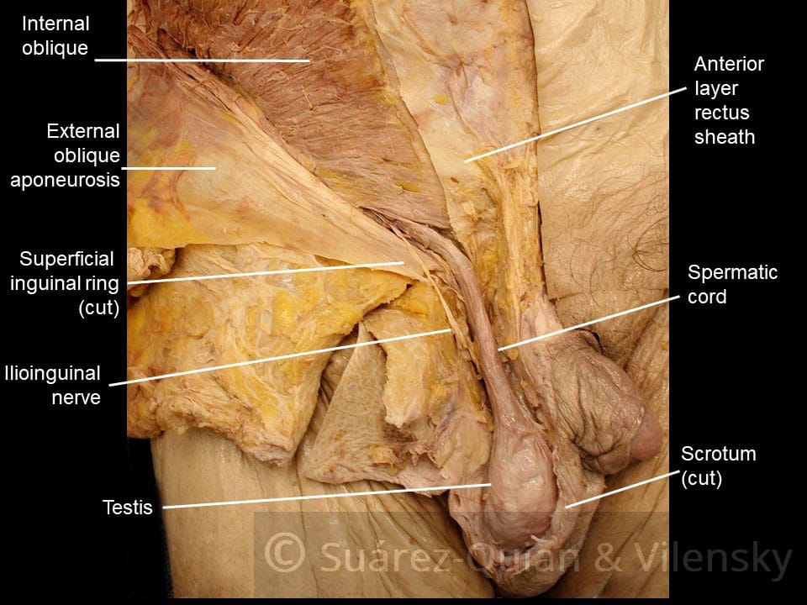

Slide 8
Content
In the males, it allows structures to pass to and from the testis to the abdomen.
In females it allows the round ligament of the uterus to pass from the uterus to the labium majus.
The inguinal canal also contains blood and lymphatic vessels and the ilioinguinal nerve in both sexes.

Slide 9
Contents
The contents of the inguinal canal include:
Spermatic cord (biological males only) – contains neurovascular and reproductive structures that supply and drain the testes.
Round ligament (biological females only) – originates from the uterine horn and travels through the inguinal canal to attach at the labia majora.
Ilioinguinal nerve – contributes towards the sensory innervation of the genitalia
  Note: only travels through part of the inguinal canal, exiting via the superficial inguinal ring (it does not pass through the deep inguinal ring)
  This is the nerve most at risk of damage during an inguinal hernia repair.
Genital branch of the genitofemoral nerve – supplies the cremaster muscle and anterior scrotal skin in males, and the skin of the mons pubis and labia majora in females.
The walls of the inguinal canal are usually collapsed around their contents, preventing other structures from potentially entering the canal and becoming stuck.

Slide 10
Clinical Relevance: Inguinal Hernia
A hernia is defined as the protrusion of an organ or fascia through the wall of a cavity that normally contains it. Hernias involving the inguinal canal can be divided into two main categories:
Indirect – where the peritoneal sac enters the inguinal canal through the deep inguinal ring.
Direct – where the peritoneal sac enters the inguinal canal though the posterior wall of the inguinal canal.
Both types of inguinal hernia can present as lumps in the scrotum or labia majora.
Indirect Inguinal Hernia
Indirect inguinal hernias are the more common of the two types. They are caused by the failure of the processus vaginalis to regress.
The peritoneal sac (and potentially loops of bowel) enters the inguinal canal via the deep inguinal ring. The degree to which the sac herniates depends on the amount of processus vaginalis still present.

Slide 11
Large herniations are possible in which the peritoneal sac and its contents may traverse the entire inguinal canal, emerge through the superficial inguinal ring, and reach the scrotum.
Direct Inguinal Hernia
In contrast to the indirect hernia, direct inguinal hernias are acquired, usually in adulthood, due to weakening in the abdominal musculature.
The peritoneal sac bulges into the inguinal canal via the posterior wall medial to the epigastric vessels and can enter the superficial inguinal ring. The sac is not covered with the coverings of the contents of the canal.

Slide 12
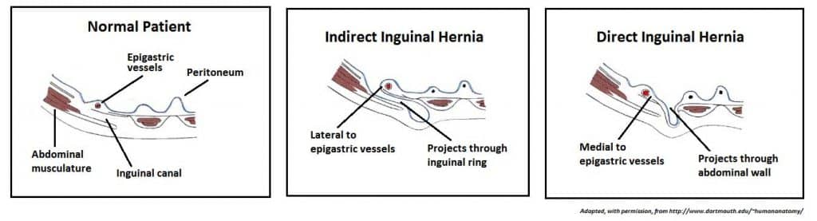

Slide 13
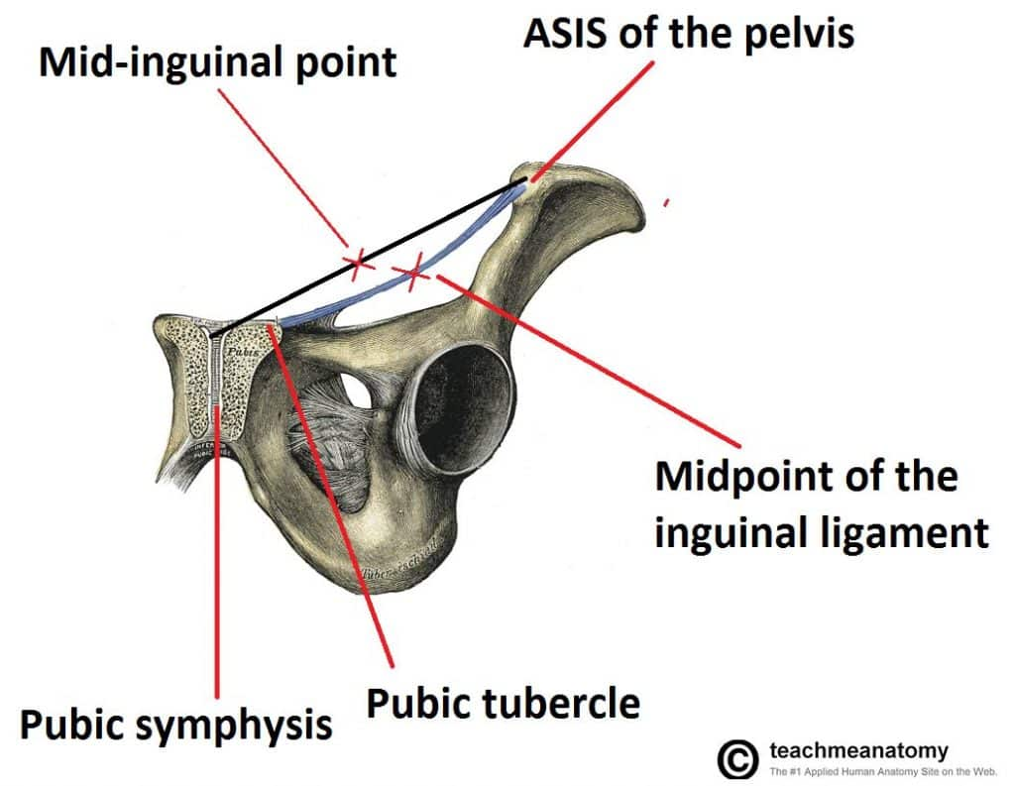
Mid-Inguinal Point and Midpoint of the Inguinal Ligament
Mid-inguinal point – halfway between the pubic symphysis and the anterior superior iliac spine. The femoral pulse can be palpated here.
Midpoint of the inguinal ligament – halfway between the pubic tubercle and the anterior superior iliac spine (the two attachments of the inguinal ligament). The opening to the inguinal canal is located just above this point.
By Te(2024)

